Slide 1
Poverty

Slide 2
The poverty rate of households with children under 5 is slightly higher than the poverty rate of all LA County households
There are
57,407
households in L.A. County with children under 5 in poverty
Source: American Community Survey Public Use Microdata 1-Year Estimates, 2022. Note: Poverty is defined as having income at or below 100% of the federal poverty level.
Notes:
Talking Points:
…

Slide 3
Poverty rates have decreased in the last ten years for households with children under 5
Source: American Community Survey Public Use Microdata 1-Year Estimates, 2013-2022. No data were published for 2020 due to the pandemic. Note: Poverty is defined as having income at or below 100% of the federal poverty level.

Slide 4
Latinx and Black poverty rates are more than double the White poverty rate.
Source: American Community Survey Public Use Microdata 5-Year Estimates, 2018-2022.

Slide 5
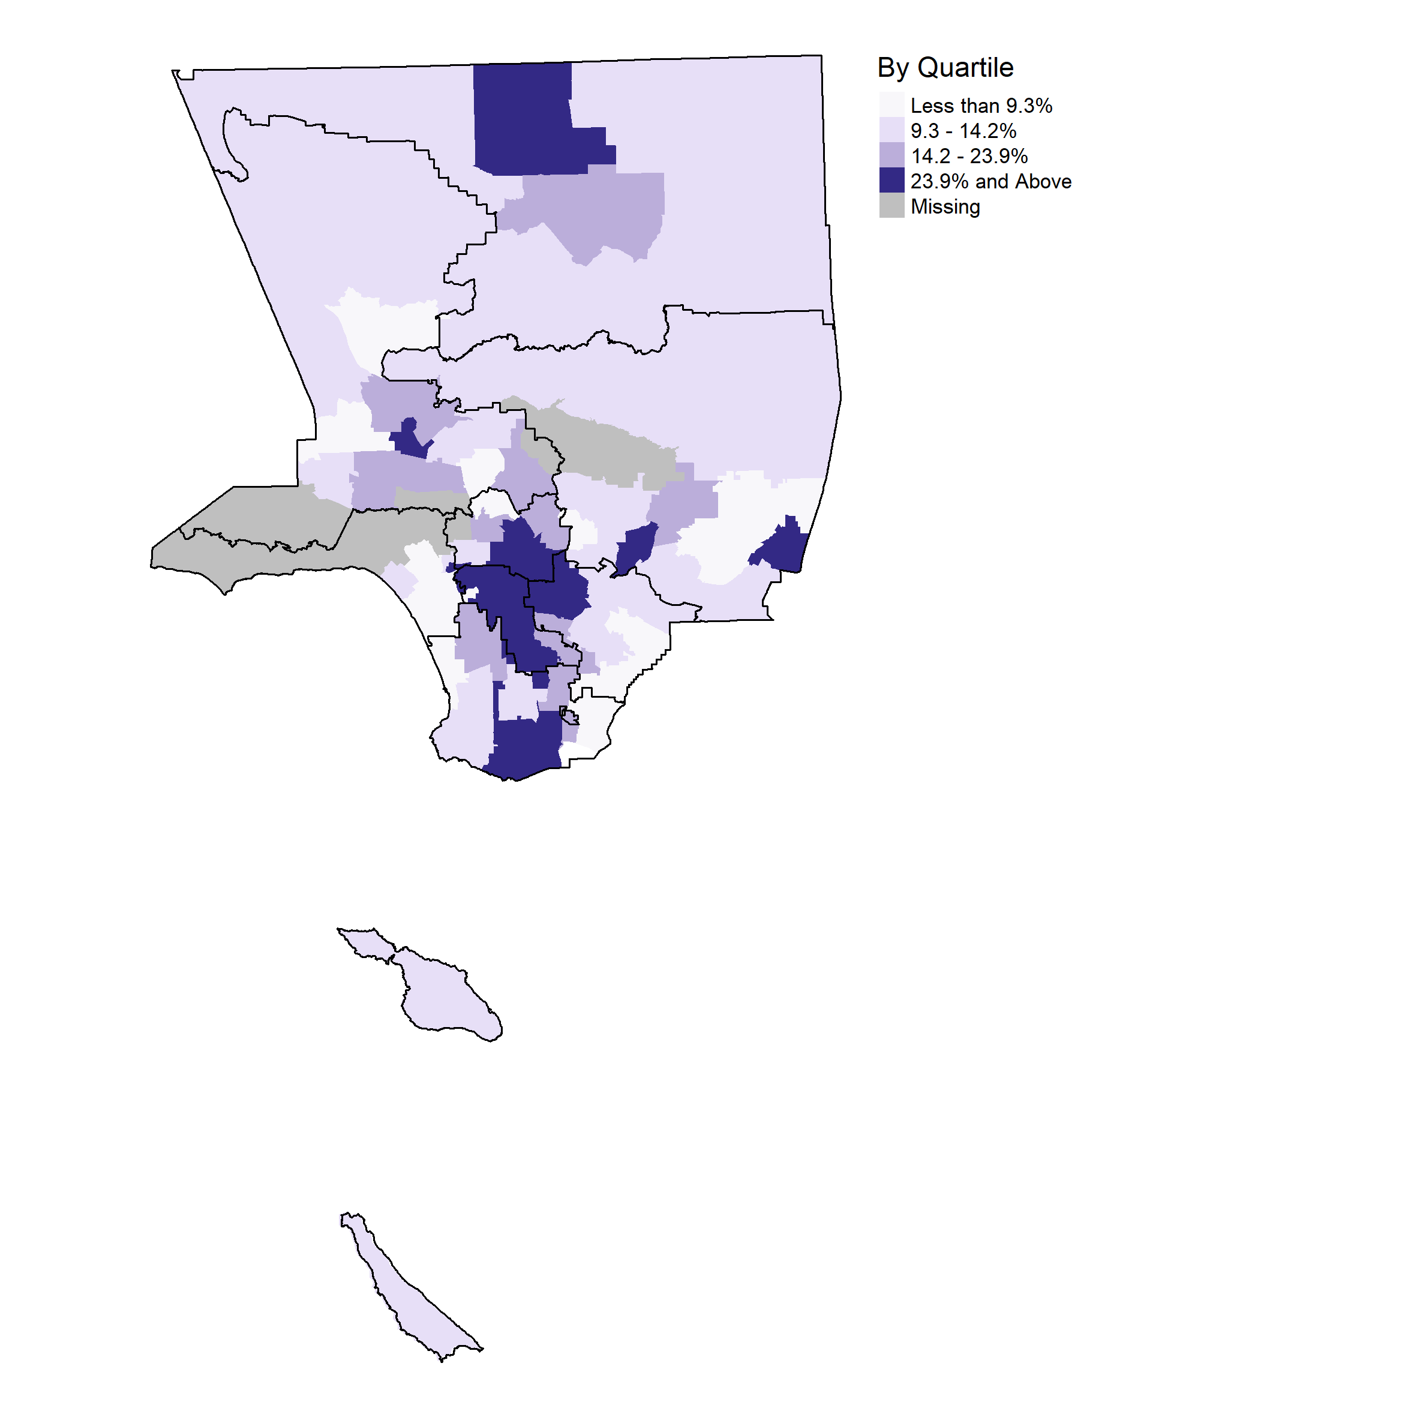
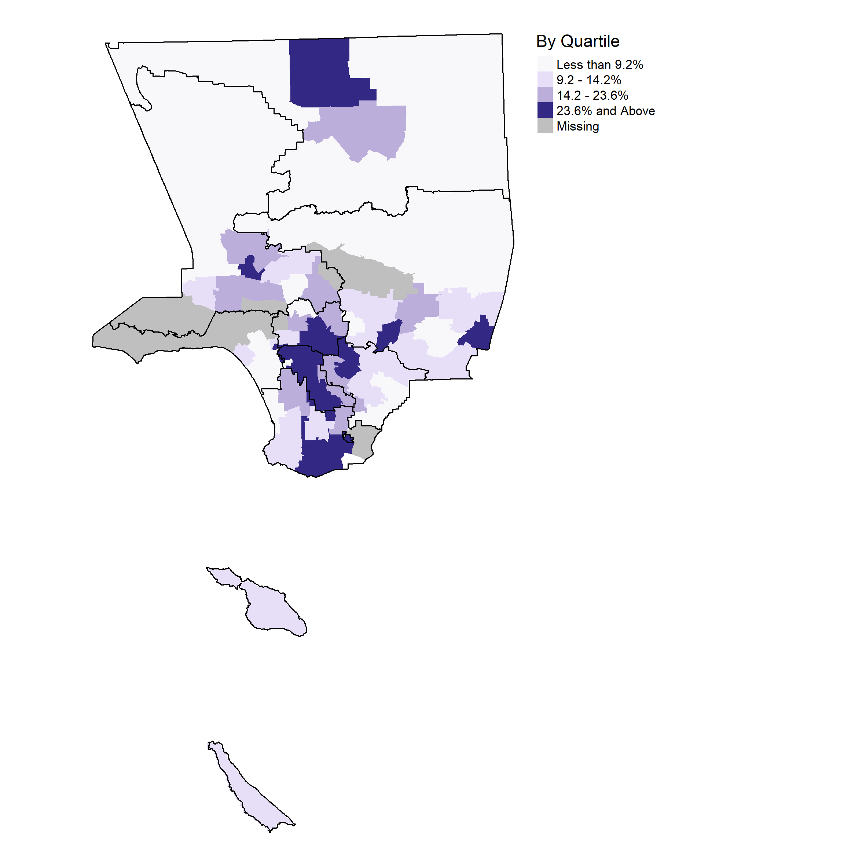
Percent of households with children under 5 with income at or below the federal poverty level
1
2
3
4
5
6
7
Not to scale
8
SPAs (2021) outlined and numbered
Source: American Community Survey Public Use Microdata 5-Year Estimates, 2021. Note: Poverty is defined as having income at or below 100% of the federal poverty level. Shaded areas are Public Use Microdata Areas (PUMAs), Census geographies of 100,000 people or more. Missing data are statistically unstable estimates due to small sample size.
Notes:
PUMAs with an overlay of SPAs

